Slide 1
Uninformed (also called blind) search algorithms)

Slide 2
Outline
Overview of uninformed search methods
Search strategy evaluation
  Complete? Time? Space? Optimal?
  Max branching (b), Solution depth (d), Max depth (m)
Search Strategy Components and Considerations
  Queue? Goal Test when? Tree search vs. Graph search?
Various blind strategies:
  Breadth-first search
  Uniform-cost search
  Depth-first search
  Iterative deepening search (generally preferred)
  Bidirectional search (preferred if applicable)

Slide 3
Uninformed search strategies
Uninformed (blind):
  You have no clue whether one non-goal state is better than any other. Your search is blind. You don’t know if your current exploration is likely to be fruitful.
Various blind strategies:
  Breadth-first search
  Uniform-cost search
  Depth-first search
  Iterative deepening search (generally preferred)
  Bidirectional search (preferred if applicable)

Slide 4
Search strategy evaluation
A search strategy is defined by the order of node expansion
Strategies are evaluated along the following dimensions:
  completeness: does it always find a solution if one exists?
  time complexity: number of nodes generated
  space complexity: maximum number of nodes in memory
  optimality: does it always find a least-cost solution?
Time and space complexity are measured in terms of
  b: maximum branching factor of the search tree
  d: depth of the least-cost solution
  m: maximum depth of the state space (may be ∞)

Slide 5
Uninformed search strategies
Queue for Frontier:
  FIFO? LIFO? Priority?
Goal-Test:
  When inserted into Frontier? When removed?
Tree Search or Graph Search:
  Forget Explored nodes? Remember them?

Slide 6
Queue for Frontier
FIFO (First In, First Out)
  Results in Breadth-First Search
LIFO (Last In, First Out)
  Results in Depth-First Search
Priority Queue sorted by path cost so far
  Results in Uniform Cost Search
Iterative Deepening Search uses Depth-First
Bidirectional Search can use either Breadth-First or Uniform Cost Search

Slide 7
When to do Goal-Test?
When generated? When popped?
Do Goal-Test when node is popped from queue
IF you care about finding the optimal path
AND your search space may have both short expensive and long cheap paths to a goal.
  Guard against a short expensive goal.
  E.g., Uniform Cost search with variable step costs.
Otherwise, do Goal-Test when is node inserted.
  E.g., Breadth-first Search, Depth-first Search, or Uniform Cost search when cost is a non-decreasing function of depth only (which is equivalent to Breadth-first Search).
REASON ABOUT your search space & problem.
  How could I possibly find a non-optimal goal?

Slide 8

Breadth-first search
Expand shallowest unexpanded node
Frontier (or fringe): nodes in queue to be explored
Frontier is a first-in-first-out (FIFO) queue, i.e., new successors go at end of the queue.
Goal-Test when inserted.
Future= green dotted circles
Frontier=white nodes
Expanded/active=gray nodes
Forgotten/reclaimed= black nodes
Initial state = A
Is A a goal state?
Put A at end of queue.
frontier = [A]

Slide 9

Breadth-first search
Expand shallowest unexpanded node
Frontier is a FIFO queue, i.e., new successors go at end
Expand A to B, C.
Is B or C a goal state?
Put B, C at end of queue.
frontier = [B,C]

Slide 10
Breadth-first search
Expand shallowest unexpanded node
Frontier is a FIFO queue, i.e., new successors go at end
Expand B to D, E
Is D or E a goal state?
Put D, E at end of queue
frontier=[C,D,E]

Slide 11

Breadth-first search
Expand shallowest unexpanded node
Frontier is a FIFO queue, i.e., new successors go at end
Expand C to F, G.
Is F or G a goal state?
Put F, G at end of queue.
frontier = [D,E,F,G]

Slide 12
Breadth-first search
Expand shallowest unexpanded node
Frontier is a FIFO queue, i.e., new successors go at end
Expand D to no children.
Forget D.
frontier = [E,F,G]

Slide 13
Breadth-first search
Expand shallowest unexpanded node
Frontier is a FIFO queue, i.e., new successors go at end
Expand E to no children.
Forget B,E.
frontier = [F,G]

Slide 14
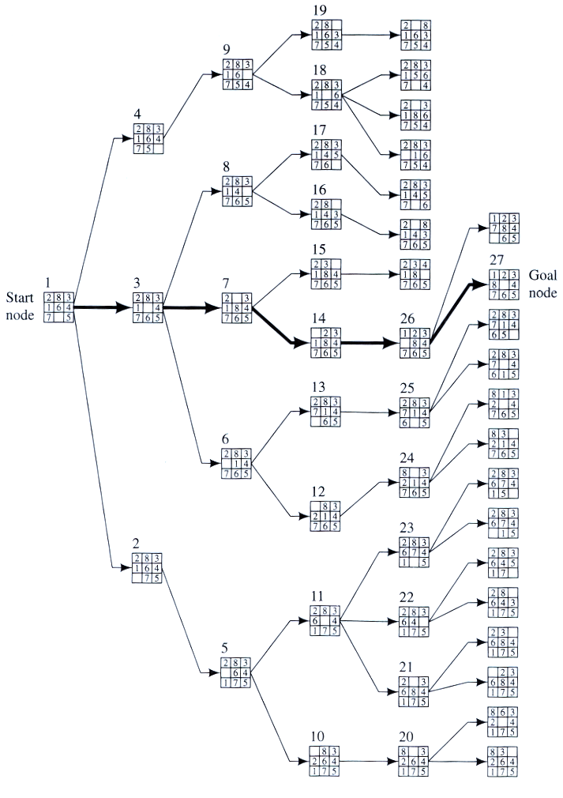
Example
BFS

Slide 15
Properties of breadth-first search
Complete? Yes, it always reaches a goal (if b is finite)
Time? 1+b+b²+b³+… + b^{d} = O(b^{d})
(this is the number of nodes we generate)
Space? O(b^{d}) (keeps every node in memory,
either in fringe or on a path to fringe).
Optimal? No, for general cost functions.
Yes, if cost is a non-decreasing function only of depth.
    All optimal goal nodes occur on the same level
Space is the bigger problem (more than time)

Slide 16
Uniform-cost search
Uniform-cost Search:
Expand node with smallest path cost g(n).
Frontier is a priority queue, i.e., new successors are merged into the queue sorted by g(n).
  Can remove successors already on queue w/higher g(n).
    Saves memory, costs time; another space-time trade-off.
Goal-Test when node is popped off queue.

Slide 17
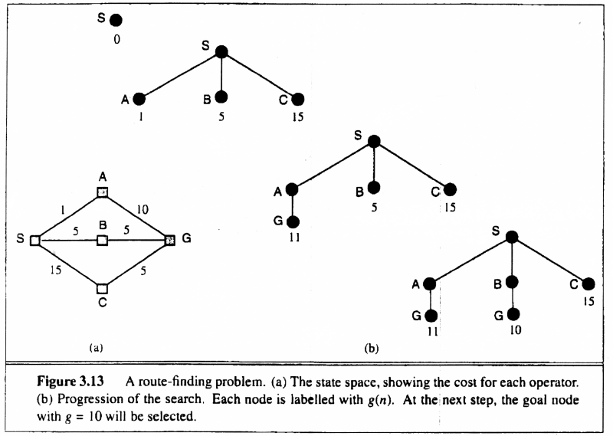
Uniform-cost search
Uniform-cost Search:
Expand node with smallest path cost g(n).
Proof of Completeness:
Given that every step will cost more than 0,
and assuming a finite branching factor, there
is a finite number of expansions required before
the total path cost is equal to the path cost of the
goal state. Hence, we will reach it.
Proof of optimality given completeness:
Assume UCS is not optimal.
Then there must be an (optimal) goal state with
path cost smaller than the found (suboptimal) goal
state (invoking completeness).
However, this is impossible because UCS would
have expanded that node first by definition.
Contradiction.

Slide 18
Uniform-cost search
Implementation: Frontier = queue ordered by path cost.
Equivalent to breadth-first if all step costs all equal.
Complete? Yes, if b is finite and step cost ≥ ε > 0.
(otherwise it can get stuck in infinite loops)
Time? # of nodes with path cost ≤ cost of optimal solution.
O(b^{⎣C*/ε⎦}) ≈ O(b^{d})
Space? # of nodes with path cost ≤ cost of optimal solution.
O(b^{⎣C*/ε⎦}) ≈ O(b^{d})
Optimal? Yes, for any step cost ≥ ε > 0.

Slide 19

Depth-first search
Expand deepest unexpanded node
Frontier = Last In First Out (LIFO) queue, i.e., new successors go at the front of the queue.
Goal-Test when inserted.
Future= green dotted circles
Frontier=white nodes
Expanded/active=gray nodes
Forgotten/reclaimed= black nodes
Initial state = A
Is A a goal state?
Put A at front of queue.
frontier = [A]

Slide 20

Depth-first search
Expand deepest unexpanded node
  Frontier = LIFO queue, i.e., put successors at front
Expand A to B, C.
Is B or C a goal state?
Put B, C at front of queue.
frontier = [B,C]
Future= green dotted circles
Frontier=white nodes
Expanded/active=gray nodes
Forgotten/reclaimed= black nodes

Slide 21

Depth-first search
Expand deepest unexpanded node
  Frontier = LIFO queue, i.e., put successors at front
Expand B to D, E.
Is D or E a goal state?
Put D, E at front of queue.
frontier = [D,E,C]
Future= green dotted circles
Frontier=white nodes
Expanded/active=gray nodes
Forgotten/reclaimed= black nodes

Slide 22

Depth-first search
Expand deepest unexpanded node
  Frontier = LIFO queue, i.e., put successors at front
Expand D to H, I.
Is H or I a goal state?
Put H, I at front of queue.
frontier = [H,I,E,C]
Future= green dotted circles
Frontier=white nodes
Expanded/active=gray nodes
Forgotten/reclaimed= black nodes

Slide 23

Depth-first search
Expand deepest unexpanded node
  Frontier = LIFO queue, i.e., put successors at front
Expand H to no children.
Forget H.
frontier = [I,E,C]
Future= green dotted circles
Frontier=white nodes
Expanded/active=gray nodes
Forgotten/reclaimed= black nodes

Slide 24

Depth-first search
Expand deepest unexpanded node
  Frontier = LIFO queue, i.e., put successors at front
Expand I to no children.
Forget D, I.
frontier = [E,C]
Future= green dotted circles
Frontier=white nodes
Expanded/active=gray nodes
Forgotten/reclaimed= black nodes

Slide 25

Depth-first search
Expand deepest unexpanded node
  Frontier = LIFO queue, i.e., put successors at front
Expand E to J, K.
Is J or K a goal state?
Put J, K at front of queue.
frontier = [J,K,C]
Future= green dotted circles
Frontier=white nodes
Expanded/active=gray nodes
Forgotten/reclaimed= black nodes

Slide 26

Depth-first search
Expand deepest unexpanded node
  Frontier = LIFO queue, i.e., put successors at front
Expand I to no children.
Forget D, I.
frontier = [E,C]
Future= green dotted circles
Frontier=white nodes
Expanded/active=gray nodes
Forgotten/reclaimed= black nodes

Slide 27

Depth-first search
Expand deepest unexpanded node
  Frontier = LIFO queue, i.e., put successors at front
Expand K to no children.
Forget B, E, K.
frontier = [C]
Future= green dotted circles
Frontier=white nodes
Expanded/active=gray nodes
Forgotten/reclaimed= black nodes

Slide 28

Depth-first search
Expand deepest unexpanded node
  Frontier = LIFO queue, i.e., put successors at front
Future= green dotted circles
Frontier=white nodes
Expanded/active=gray nodes
Forgotten/reclaimed= black nodes
Expand C to F, G.
Is F or G a goal state?
Put F, G at front of queue.
frontier = [F,G]

Slide 29
Properties of depth-first search
Complete? No: fails in loops/infinite-depth spaces
  Can modify to avoid loops/repeated states along path
    check if current nodes occurred before on path to root
  Can use graph search (remember all nodes ever seen)
    problem with graph search: space is exponential, not linear
  Still fails in infinite-depth spaces (may miss goal entirely)
Time? O(b^{m}) with m =maximum depth of space
  Terrible if m is much larger than d
  If solutions are dense, may be much faster than BFS
Space? O(bm), i.e., linear space!
  Remember a single path + expanded unexplored nodes
Optimal? No: It may find a non-optimal goal first

Slide 30
Iterative deepening search
To avoid the infinite depth problem of DFS,
only search until depth L,
i.e., we don’t expand nodes beyond depth L.
→ Depth-Limited Search
What if solution is deeper than L? → Increase L iteratively.
→ Iterative Deepening Search
This inherits the memory advantage of Depth-first search
Better in terms of space complexity than Breadth-first search.

Slide 31

Iterative deepening search L=0

Slide 32

Iterative deepening search L=1

Slide 33

Iterative deepening search L=2

Slide 34

Iterative Deepening Search L=3

Slide 35

Iterative deepening search
Number of nodes generated in a depth-limited search to depth d with branching factor b:
N_{DLS} = b⁰ + b¹ + b² + … + b^{d-2} + b^{d-1} + b^{d}
Number of nodes generated in an iterative deepening search to depth d with branching factor b:
N_{IDS} = (d+1)b⁰ + d b¹ + (d-1)b² + … + 3b^{d-2} +2b^{d-1} + 1b^{d}
= O(b^{d})
For b = 10, d = 5,
  N_{DLS} = 1 + 10 + 100 + 1,000 + 10,000 + 100,000 = 111,111
  N_{IDS} = 6 + 50 + 400 + 3,000 + 20,000 + 100,000 = 123,450

Slide 36
Properties of iterative deepening search
Complete? Yes
Time? O(b^{d})
Space? O(bd)
Optimal? No, for general cost functions.
Yes, if cost is a non-decreasing function only of depth.

Slide 37
Bidirectional Search
Idea
  simultaneously search forward from S and backwards from G
  stop when both “meet in the middle”
  need to keep track of the intersection of 2 open sets of nodes
What does searching backwards from G mean
  need a way to specify the predecessors of G
    this can be difficult,
    e.g., predecessors of checkmate in chess?
  which to take if there are multiple goal states?

Slide 38

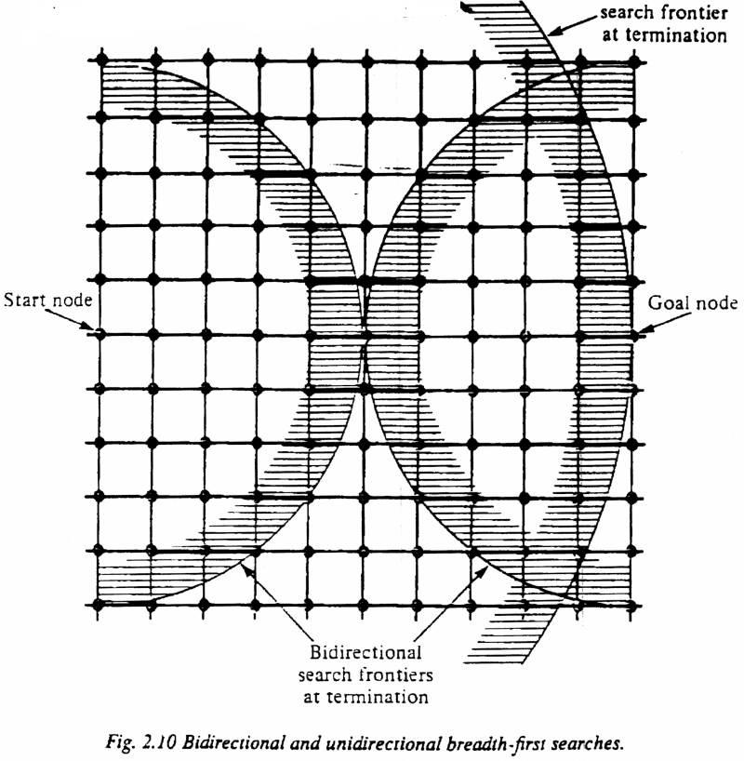
Bi-Directional Search
Complexity: time and space complexity are:

Slide 39
Summary of algorithms
Criterion | Breadth-First | Uniform-Cost | Depth-First | Depth-Limited | Iterative Deepening DLS | Bidirectional (if applicable)
Complete? | Yes[a] | Yes[a,b] | No | No | Yes[a] | Yes[a,d]
Time | O(b^{d}) | O(b^{⎣1+C*/ε⎦}) | O(b^{m}) | O(b^{l}) | O(b^{d}) | O(b^{d/2})
Space | O(b^{d}) | O(b^{⎣1+C*/ε⎦}) | O(bm) | O(bl) | O(bd) | O(b^{d/2})
Optimal? | Yes[c] | Yes | No | No | Yes[c] | Yes[c,d]
Generally the preferred
uninformed search strategy

Slide 40
Summary
Variety of uninformed search strategies
Iterative deepening search uses only linear space and not much more time than other uninformed algorithms

